Slide 1
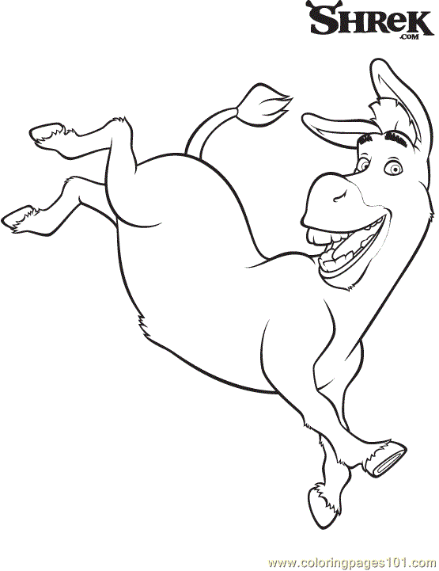
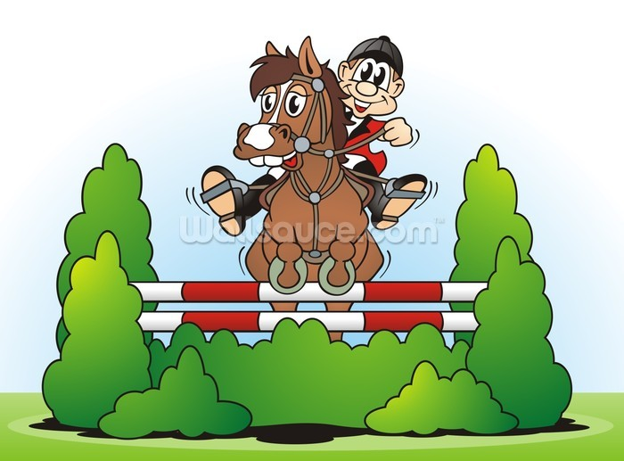
Funday Sunday at Catterick Saddle Club Sunday 10th May 2015!!
Unaffiliated Show Jumping
Class 1: 45cm Clear Round - (no prizes) 10.30 – 11.00 £4
Class 2: - 45cm (Includes Lead Rein) – Approx 11.00 – 11.30 £6
Class 3:- 55cm - £6
Approx 1145 - 1230
Class 4:- 65cm - £6
Approx 1245 - 1330
Class 5:- 75cm - £6
Approx 1345 - 1415
Class 6:- 85cm - £6
Approx 1430 – 1500
Prizes & Ribbons :- 1st – 3^{rd,} Prize giving after each class.
Times are approximate pending entries.
Dress Code: No dress code required. Personal Protective equipment must be worn
All Competitors enter this event at their own risk.
Entries taken on the day. Contact 01748 889360 for more info
Refreshments at the Catering Cabin
Kicking Mule

Slide 2
Funday Sunday at Catterick Saddle Club Sunday May 10th
Kicking Mule Show Jumping Competitions are different to any other locally!
Our aim is to provide a Fun & Friendly day
No one leaves the arena without achieving
No Eliminations, No Dress code, No Pressure, Affordable Entries
If you are looking to improve jumping confidence this is an ideal place to start!
The smaller classes are the ‘seeds & shoots’ for those who aren’t quite ready for grassroots Competition.
For More Info please call 01748 889360

